Slide 1


Real Estate Portfolio Dashboard
Professional storytelling through data-driven insights for portfolio optimization and strategic decision-making.

Slide 2
Portfolio at a Glance
3,000
35%
33%
32%
Total Properties
Successfully Sold
Pending Deals
Listed for Sale
Comprehensive portfolio under active management
Strong conversion rate demonstrating market appeal
Active transactions progressing through pipeline
Fresh inventory ready for market engagement
Our balanced portfolio distribution indicates steady buyer-seller engagement across all market segments, positioning us well for continued growth.

Slide 3

Key Performance Indicators
Core Business Metrics
Sold Properties
Active Listings
1,045 properties successfully closed
957 properties currently marketed
Formula: CALCULATE(Total_properties, Status = "for sale")
Formula: CALCULATE(COUNTROWS, Status = "sold")
Pending Transactions
998 properties in negotiation
Significant capital tied up awaiting closure
DAX measures provide real-time visibility into portfolio performance and market dynamics.

Slide 4
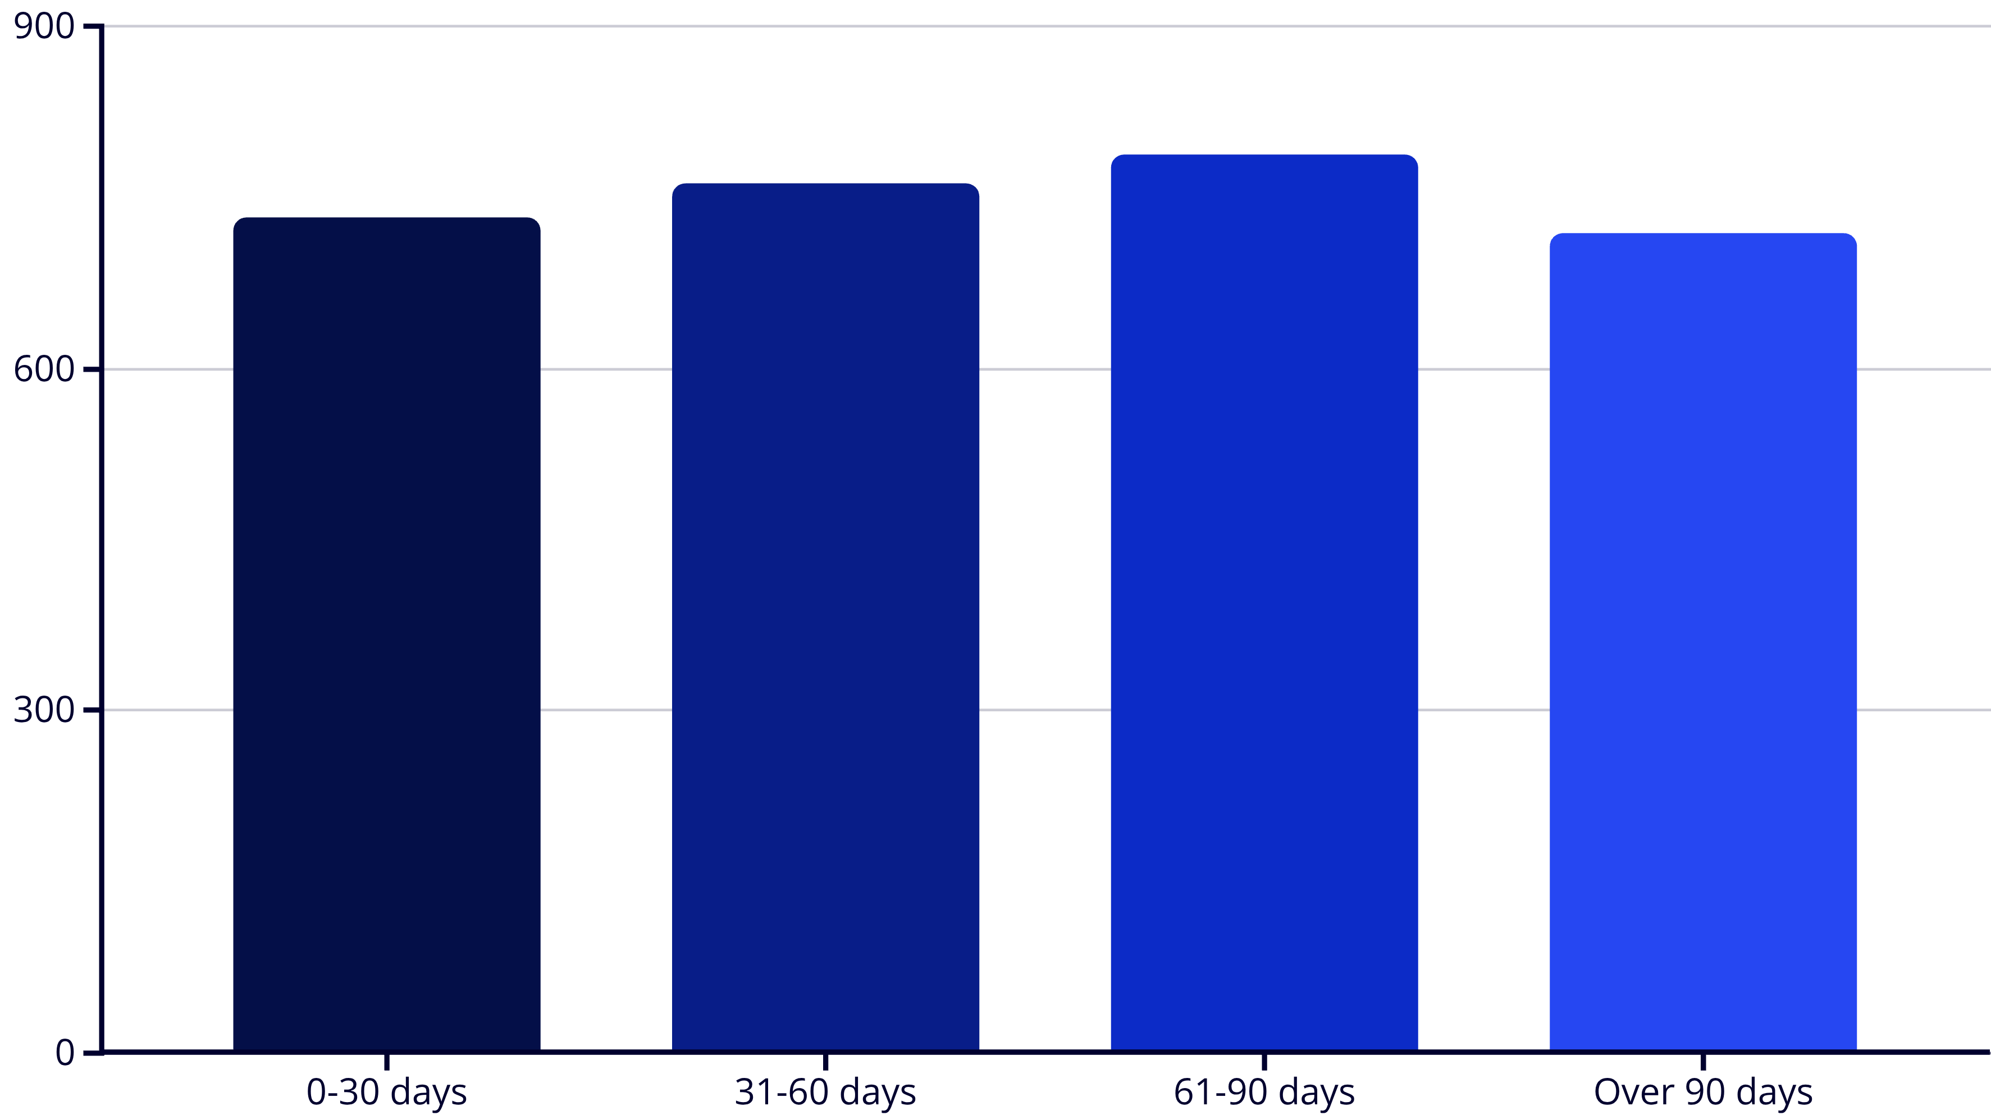
Market Velocity Analysis
Properties show relatively even distribution across time segments. However, 719 properties beyond 90 days represent potential pricing or market-fit challenges requiring immediate attention.

Slide 5
Geographic Distribution Leaders
California
Illinois
New York
Leading market with strong absorption rates in major metropolitan areas
Balanced inventory across Chicago and suburban markets
Premium market segments driving high-value transactions
Florida
Texas
Growth market with increasing buyer demand
Diverse portfolio across multiple growing cities

Slide 6



Market Performance Insights
Balanced Activity
Capital Efficiency
Growth Opportunity
Even distribution across sales funnel indicates healthy market dynamics with consistent buyer-seller engagement throughout the pipeline.
35% conversion rate demonstrates strong market appeal, while pending transactions represent significant value awaiting closure.
Geographic leaders show near-equal inventory distribution, presenting opportunities for targeted market expansion strategies.

Slide 7
Challenge Analysis
Pending Deal Bottlenecks
Negotiation and financing delays creating cash flow risks in high-value transactions
Identifying bottlenecks early enables proactive intervention strategies to optimize portfolio performance.
Stagnant Inventory
Properties over 90 days suggesting pricing misalignment or reduced market visibility
➡️ Bottleneck Identified: The large share of pending inventory is slowing overall portfolio turnover.
Regional Variance
Cities like Fresno and San Francisco showing different absorption patterns

Slide 8
Strategic Recommendations
01
02
03
Reassess Stagnant Properties
Accelerate Pending Closures
Benchmark Performance
Implement pricing adjustments and enhanced marketing strategies for properties exceeding 90 days on market
Streamline financing processes and eliminate bottlenecks on high-value pending transactions
Apply 35% sold rate standard to underperforming segments and property categories
04
05
Optimize Property Mix
Monitor Lead Indicators
Focus on apartments and single-family homes showing faster movement patterns
Track pending percentage, sales percentage, and days on market as early-warning metrics

Slide 9

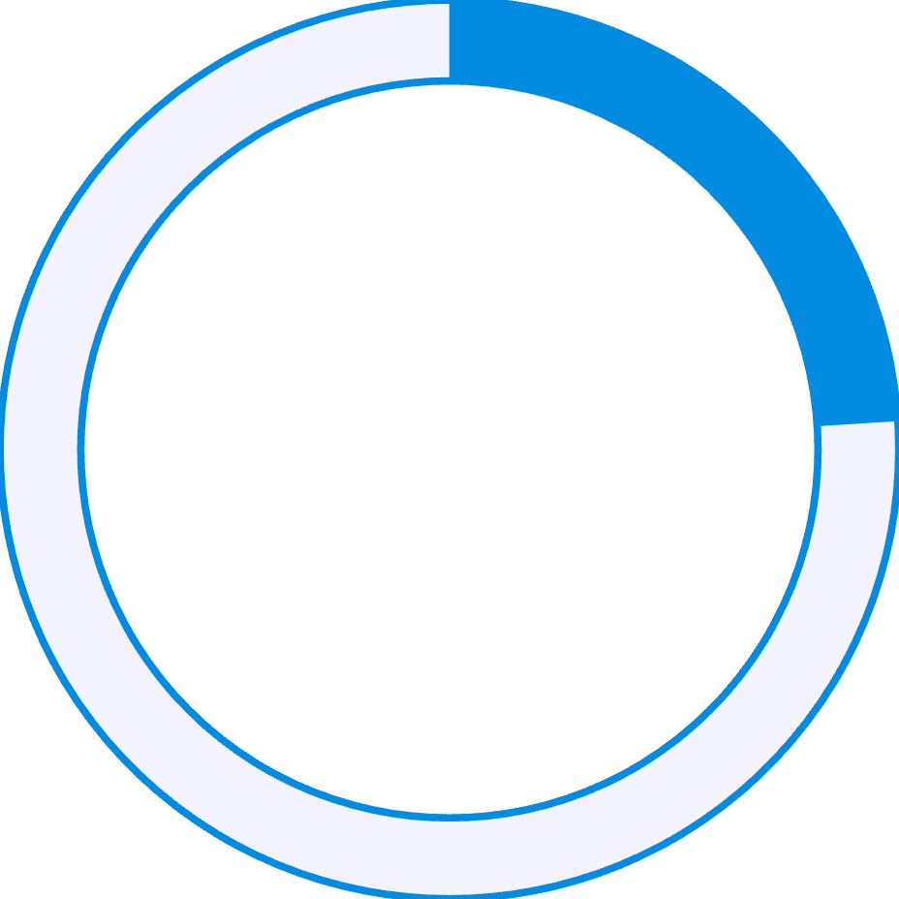

Portfolio Health Assessment
75%
24%
85%
Market Activity Score
At-Risk Inventory
Geographic Coverage
Strong balance between sold and active listings
Properties requiring immediate attention (>90 days)
Well-distributed across top-performing markets
Overall portfolio demonstrates strong fundamentals with targeted opportunities for optimization in specific segments.

Slide 10




Next Steps Forward
Immediate Action
Address aging inventory and pending deal bottlenecks within 30 days
Strategic Optimization
Implement winning tactics from high-performing segments across entire portfolio
Continuous Monitoring
Establish dashboard tracking for proactive portfolio management and revenue optimization
Transform challenges into opportunities through data-driven decision making and strategic portfolio optimization for improved revenue flow and healthier inventory cycles.

